Slide 1



Sleep Health and Lifestyle
DSC-2010
Jayden Cruz

Slide 2
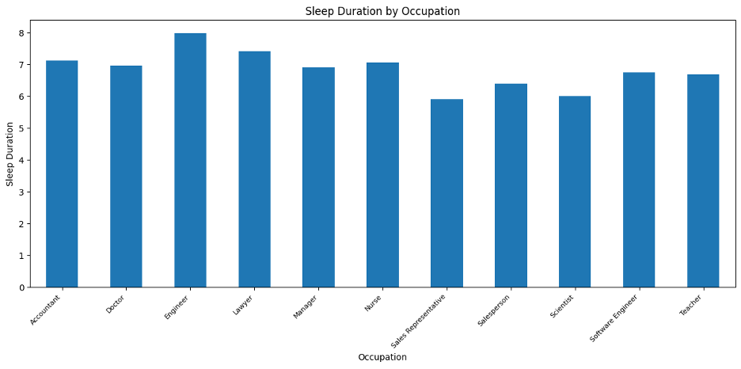

Average Hours of Sleep

Slide 3
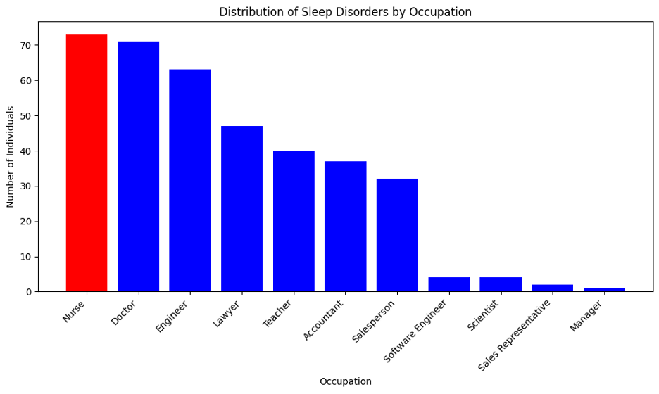
Sleep Disorders by Occupation

Slide 4
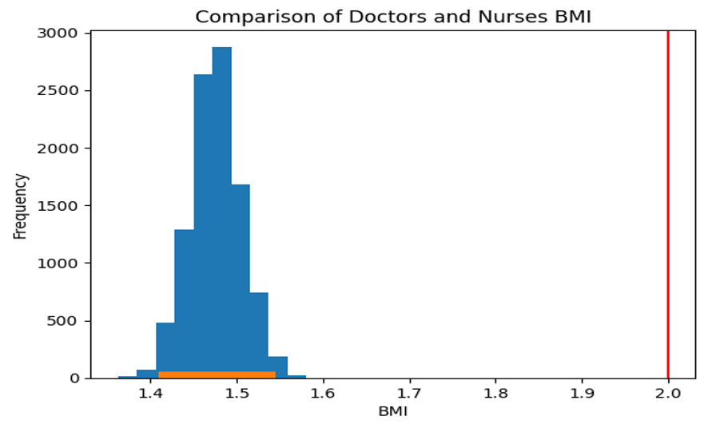
Hypothesis Testing: Bootstrapped confidence Interval

Slide 5

Thanks

